Slide 1
School is Cool Inc.
Process & Data Management
Team 3: Abigail Guo, Shelby Iapoce-Lintz, Zhihao Jin, Giovana Kishi, Rahul Sinha, Haotian Zhao

Slide 2

AGENDA
Background
Business Process Improvement
Data Management System
ERD Overview
Report Demonstration
Key Takeaways/Next Steps

Slide 3
BACKGROUND

Slide 4

Business Overview
Toy company based in the U.S. and operates internationally
Large variety of toy products and brands
Key customers are retailer companies
Notes:
Add toy pictures

Slide 5




Business Challenges Overview
Customers receiving orders in too many shipments
Inefficient Warehouse Management
Large amount of internal data stored in non-dynamic format
Cross-functional teams cannot align on most up-to-date data
Difficulty making high level strategic decisions in a timely manner

Slide 6
3 Key Reasons for Business Challenges
1
2
3
Company Growth &
Location Changes
More employees hired
Decentralization of information
Large IP Sensitive Brand Portfolio
IP sensitive properties
Compliance
External
Environment
Technology advances
Consumer expectations
Security concerns

Slide 7
Process Review
Step 1
Step 2
Step 3
Step 4
Step 5
Met as a management team to identify key business challenges for School is Cool Inc.
Brainstormed key considerations for
1. Customer shipment challenges
2. Data management
challenges
Created as-is versus to-be business processes
Designed new data management system focusing on needs of sales team and warehouse team
Assessed and refined the business process improvement and data management solution outputs
Share business process improvement and new data management system + reports with broader team

Slide 8
Key Deliverables
Business
Process
Improvement
Data
Management
System

Slide 9
Business Process Improvement

Slide 10
As-Is
To-Be
Inefficient Order Placement:
Sales reps do not have visibility on available products before sales meetings
Need to involve order management team to check product availability
Seamless Order Placement:
Grant sales teams access to inventory system or production schedule
Sales teams to have more autonomy in the entire process
High Cost Order Fulfillment:
Orders were sent out to customers in different shipments based on inventory levels in each warehouse
Centralize Order Fulfillment:
Designate one warehouse as a hub, and ship all products from that hub
Reduce costs and improve customer experience
Notes:
NOTE: Arrow, and To-Be are animated

Slide 11
Data Management System

Slide 12
ERD OVERVIEW

Slide 13

ERD Considerations
Ability to generate dynamic business reports for management/sales/warehouse teams
Database design, debugging and creation
Ease of viewing & updating data
Reveal database problems easier

Slide 14
PK Sales_Rep_ID
Sales_Rep_Name
Sales_Rep_Salary
Sales_Rep_Email
SALES_REPRESENTATIVE
PK Warehouse_ID
Warehouse_Address
Warehouse_City
WAREHOUSE
SUPPLIER
PK Supplier_ID
Supplier_Name
Supplier_Quality_Evaluation
ERD Key
Associative Entity
Entity
Primary key
Foreign Key
1:M
1:M
1:M
1:1
1:1
1:1
PK Raw_Material_ID
Raw_Material_Name
Raw_Material_Cost
FK Supplier_ID
PK FK Warehouse_ID
PK FK Product_ID
WH_Inventory_by_Product
RAW_MATERIAL
PK Customer_ID
Customer_Name
Customer_Email
FK Sales_Rep_ID
WH_PRODUCT_DATA
CUSTOMER
BRAND
1:1
PK Brand_ID
Brand_Name
Brand_Category
1:M
1:M
1:M
PRODUCT
1:1
1:1
PK Product_ID
Product_Name
Product_Launch_Date Product_Price
Product_Cost
Product_Line
FK Brand_ID
PK FK Customer_ID
PK FK Product_ID
Product_Quantity Transaction_Revenue
PK FK Product_ID
PK FK Raw_Material_ID
Product_RM_Quantity
Product_Cost_by_RM
1:M
TRANSACTIONS
1:1
1:M
1:M
1:1
PRODUCT_COST
1:1

Slide 15
REPORT
DEMONSTRATION

Slide 16
Report 1: Sales Representative Performance
Report Elements
Business Value
Determine annual bonus compensation
Assess base salary compensation
Increase training as needed
Identify upselling & cross-selling opportunities
Sales Rep ID
Sales Rep Name
Sales Rep Salary
Total Sales
% of Total Sales
Avg Sales/Customer

Slide 17
Report 2: Contribution Margin by Product
Report Elements
Product ID
Product Name
Product Line
Price/Unit
Total Raw Material Cost
Total Labor Cost
Contribution Margin (CM)
Business Value
Assess portfolio to prioritize sales of higher contribution margin products
Allocate resources accordingly
Assess which variable costs most negatively impact CM

Slide 18
Report 3: Product Recommender
Report Elements
Antecedent Product
Product Recommendation
Support
Lift
Model Parameters
Business Value
Increases cross sell probability
Data-driven recommendations
More value from Data Management Solution

Slide 19
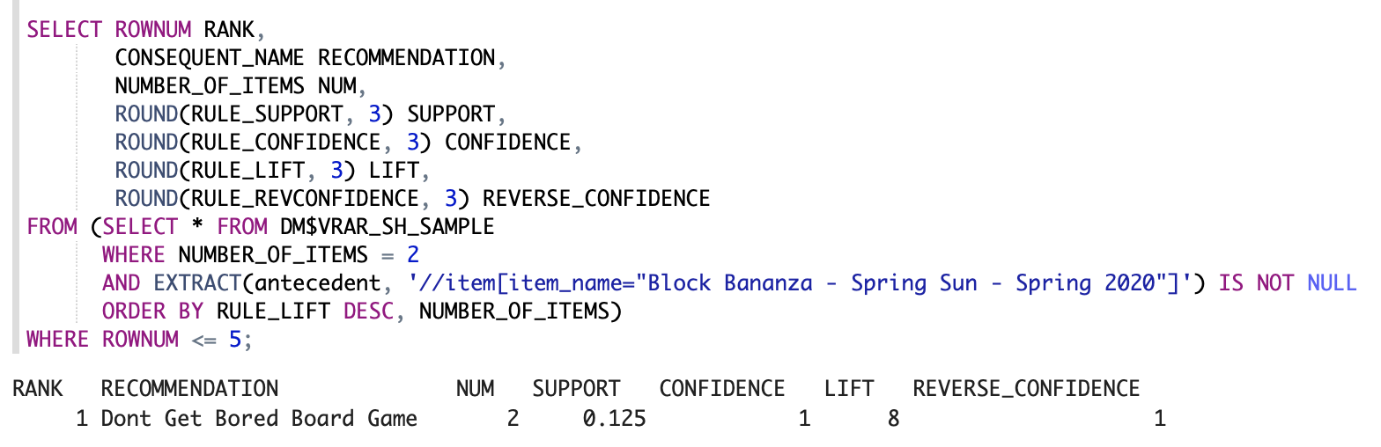
Report 3: Product Recommender

Slide 20
Key Takeaways/Next Steps

Slide 21
Key Takeaways
Project was an important first step for SIC data management improvement from old Excel system
Launching a new Data Management System and its reports improve SIC performance by using the following enablers:
Information Technology
Motivation and Measurement
Process and system improvements combined are powerful to improve business performance

Slide 22
Next Steps
Add more departments to the Data Management System (Finance)
Assess new opportunities in as-is processes for continuous process improvement
Build capacity to leverage Data Miner extension to create Predictive Reports

Slide 23
APPENDIX
Notes:
Shelby: As is, to be, full ERD, sql script for both reports

Slide 24
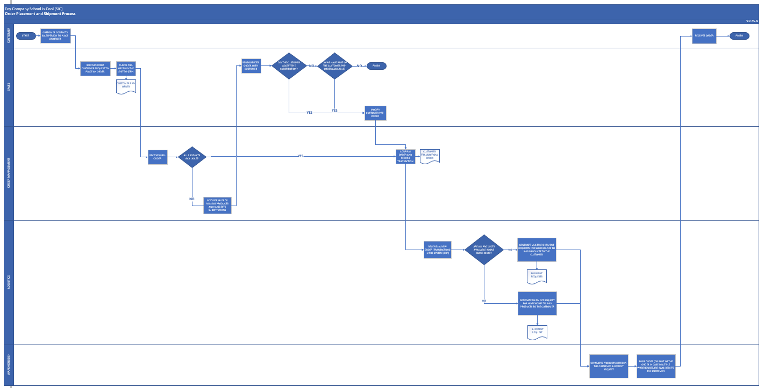
As Is Process

Slide 25
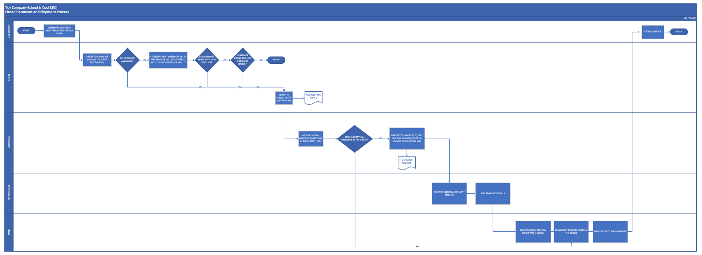
To Be Process

Slide 26
Report 1: Sales Representative Performance (Script)
select s.sales_rep_id, s.sales_rep_name
, s.sales_rep_salary
, nvl(sum(t.transactions_revenue), 0) "TOTAL_SALES"
, lpad(concat(round(nvl(sum(t.transactions_revenue)
/(select sum(transactions_revenue)
from transactions)*100, 0)
, 2), '%'), 9, ' ') "PERCENTAGE_OF_TOTAL_SALES"
, round(nvl(avg(t.transactions_revenue),0),2) "AvgSalesPerCustomer"
from transactions t join customer c
on (t.customer_id = c.customer_id)
right outer join sales_representative s
on (c.sales_rep_id = s.sales_rep_id)
group by s.sales_rep_id, s.sales_rep_name, s.sales_rep_salary
order by 4 DESC
;

Slide 27
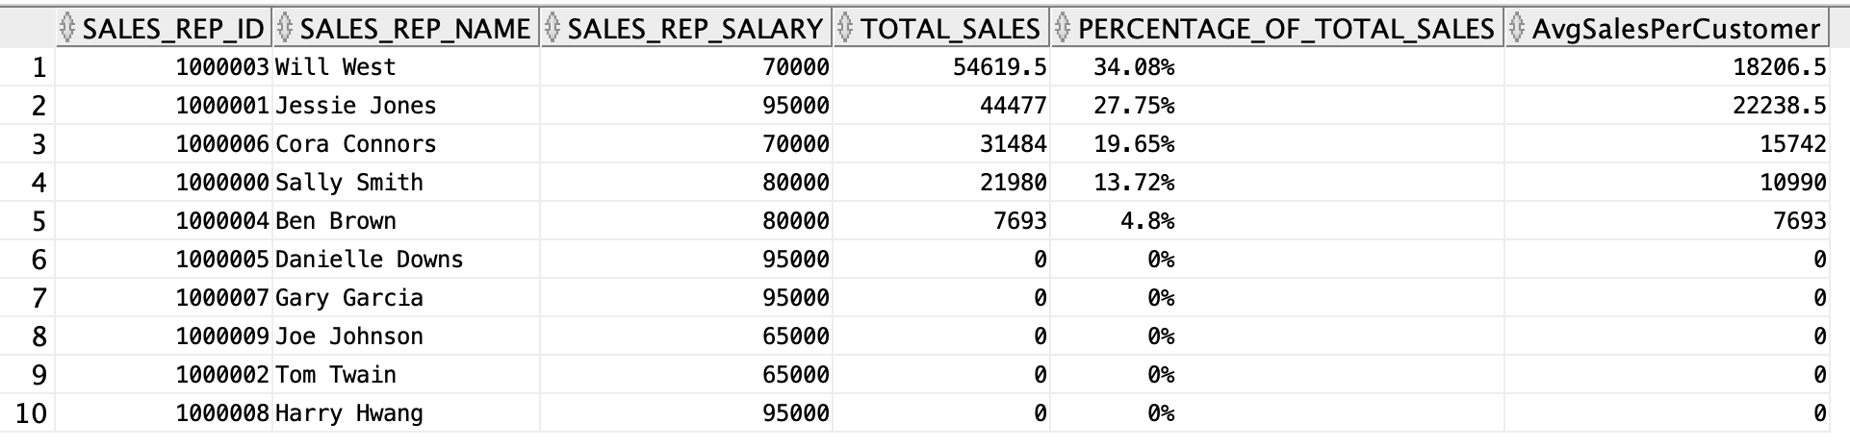
Report 1: Sales Representative Performance (Output)

Slide 28
Report 2: Contribution Margin by Product (Script)
select p.product_id
, p.product_name
, p.product_line
, p.product_price "Price per unit"
, sum(c.product_cost_by_raw_material) "RawMaterialCostPerUnit"
, sum(c.product_cost_by_labor) "LaborCostPerUnit"
, round((p.product_price - sum(c.product_cost_by_raw_material) - sum(c.product_cost_by_labor)) * 100
/(p.product_price), 2) "% ContributionMargin"
from product_cost c, product p
where p.product_id = c.product_id
group by p.product_id, p.product_name, p.product_line, p.product_price
order by 6 DESC
;

Slide 29
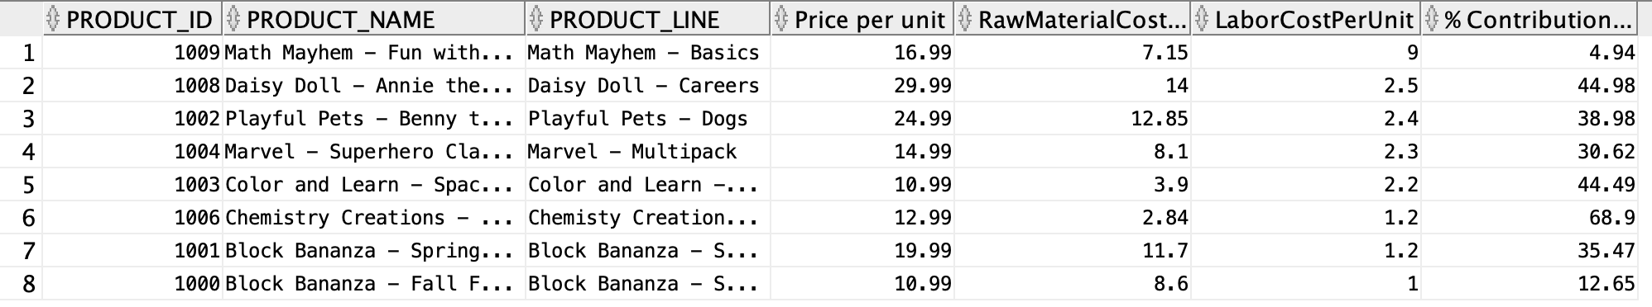
Report 2: Contribution Margin by Product (Output)

Slide 30
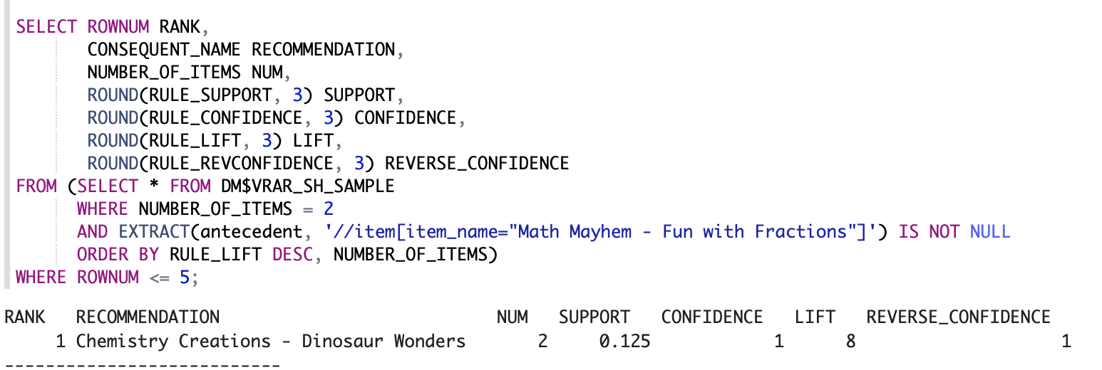
Recommendation Engine

Slide 31
Recommendation Engine

